Slide 1
Space Allocation

Slide 2
Block | Office | Seating | Lab Space | Classroom
1 | - | - |  | 3(150), 1(300)
2 | - | - | FF-2 | 1(600), 1(150)
3 | 3 |  | -
4 | 28 | 130
5 | 44 | 190
6 | 45 | 190
7 | - | - | - | 16(40), 4(70)
8 | Lal Minar
9 | Store/CPWD/IWD
10 | 0 | - | 6 Dry Labs | 1(250), 2(150), 6(70)
11 | 43 | 177 | 14 wet labs + MB + 7 Dry Lab
12 | 39 | 174 | 14 wet lab + 2 double height
13 | 44 | 171 | CIF
 | 246 | 1032

Slide 3
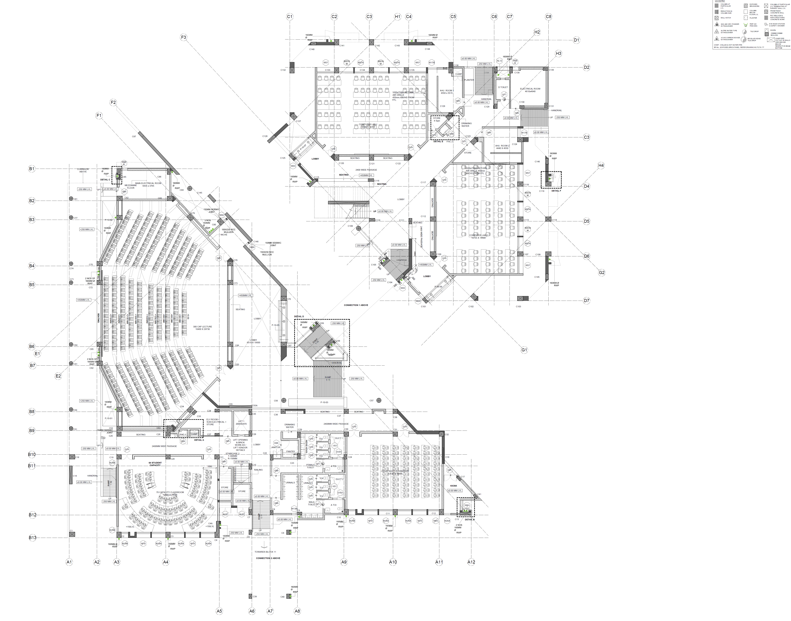
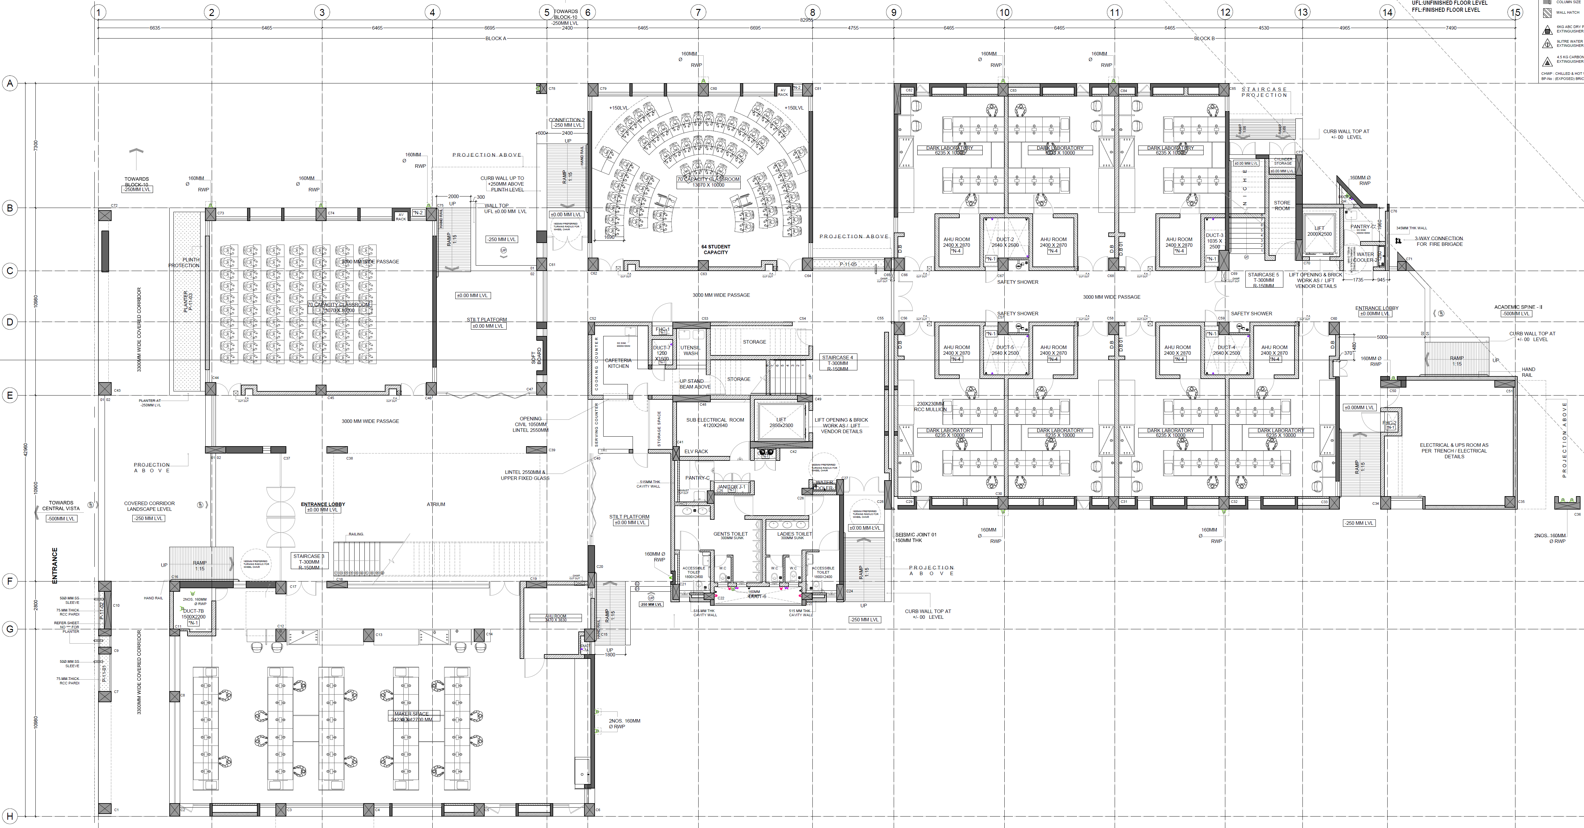
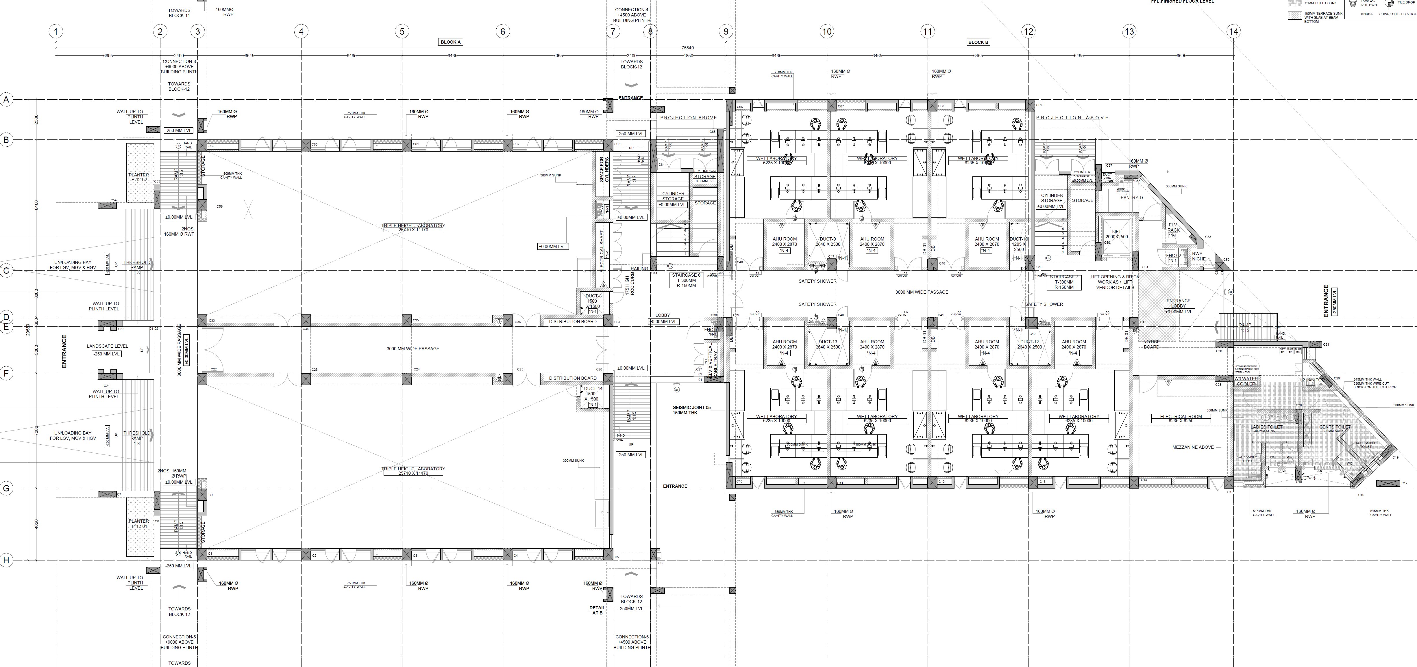
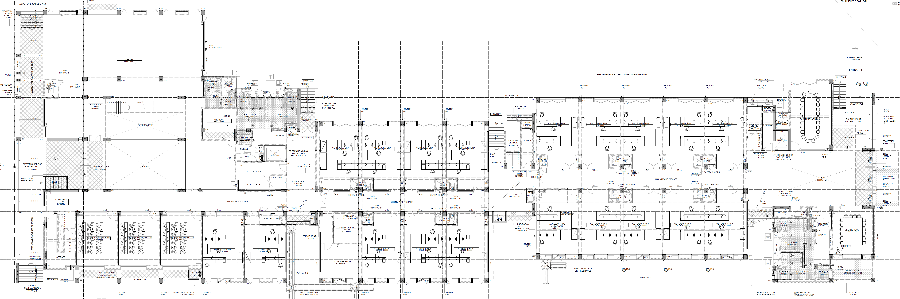
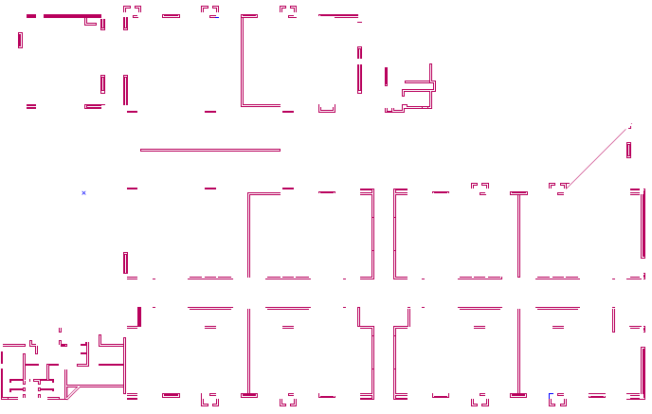
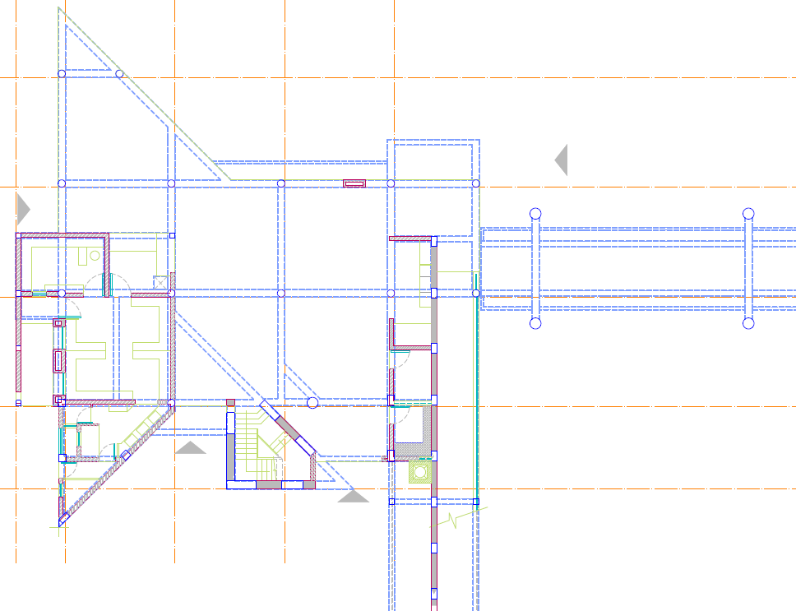
Ground Floor
AB1
AB2
Academic
102
150
103
300 CR
(Jibaben)
101
70
101
600 CR
(Jasubhai)
102
70
101
150
105
250
AB10
102
150
104
70
103
70
CCL
Admin
AA
CDS
Copy Ctr
MR
DOAA, JEE, GATE, JAM
AB3
MSE
DOSA, CDS,ISS
Reception
102
70
103
Mat. Proc.
104
105
FML
AB11
101
70
109
108
107
106
AMPRG
Server
Room
Meeting Room
ME
4-112
CL
AB5
11-110
Maker’s Bhawan
CE
e
103
104
ISTF
IMS
4-108B
12-101
CE
102
103
104
ME
CL
CE
CDAC
Super Comp
AB12
AB4
108A
CL
CL
IMS
Academic
109
108
107
106
105
101
13-101
Lib
Faculty Lounge
CE
CIF
109
110
AB13
102
103
104
105
106
107
108
109
110
111
UG Teaching Labs
117
116
115
114
113
108
Ch
ME
126
125
124
123
122
121
120
119
118
112
Stores
101
107
106
105
104
103
102
AB9
AB8
AB7
AB6

Slide 4
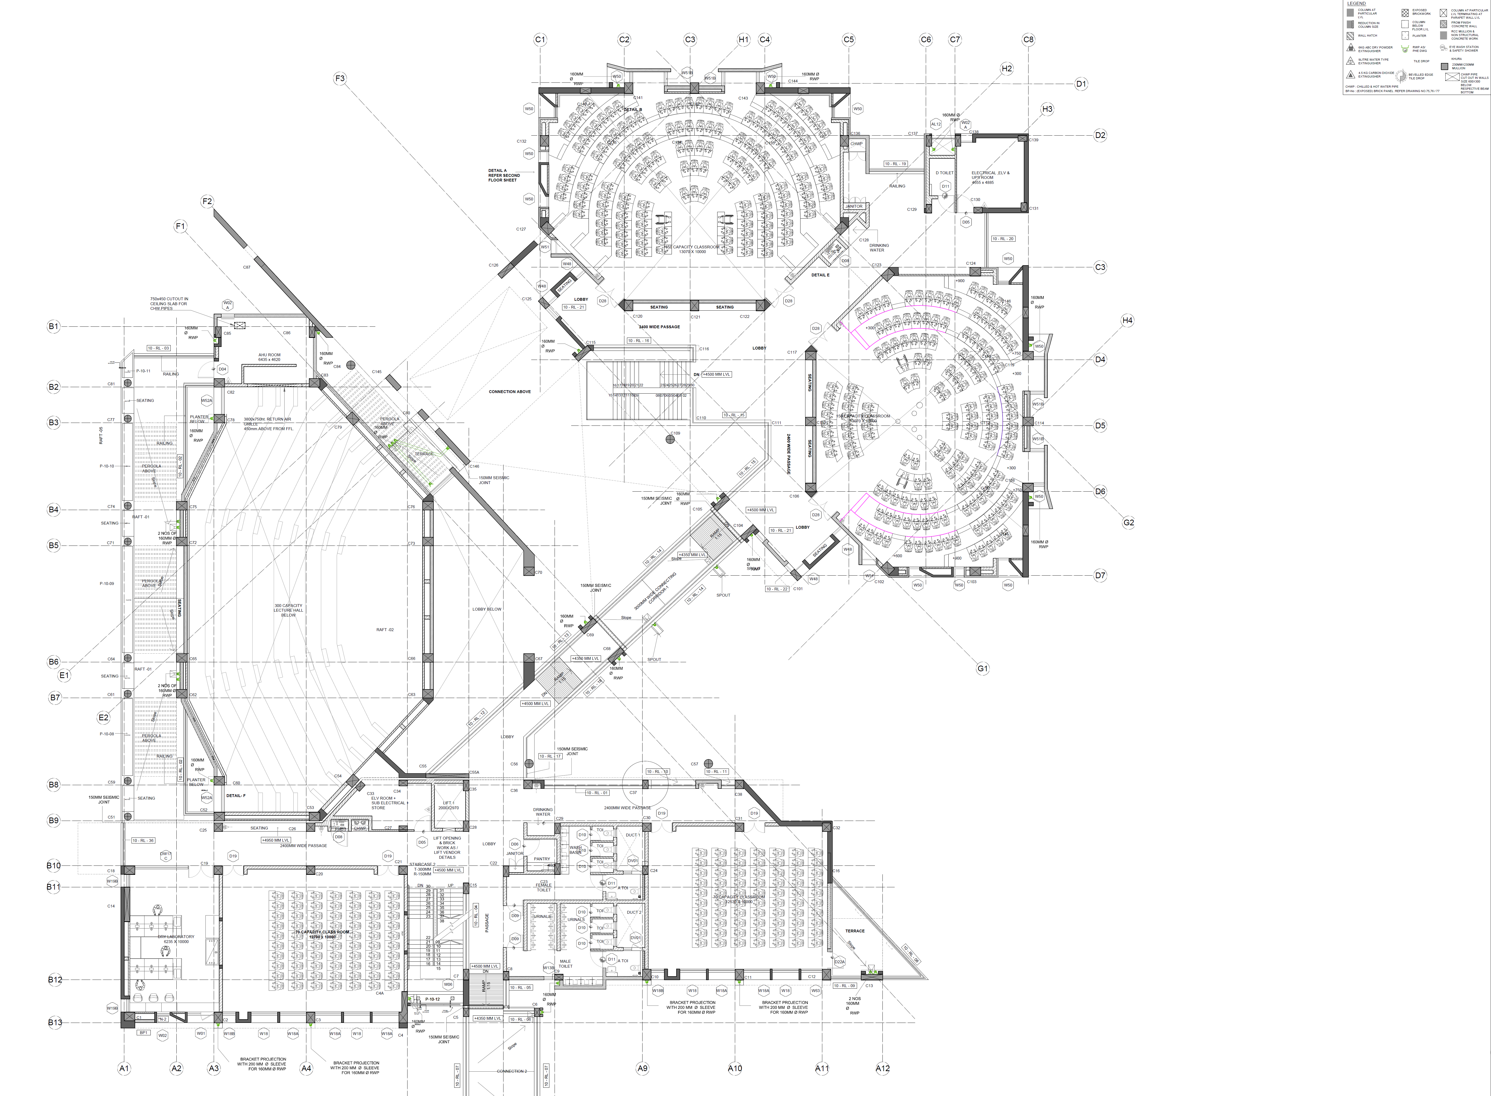
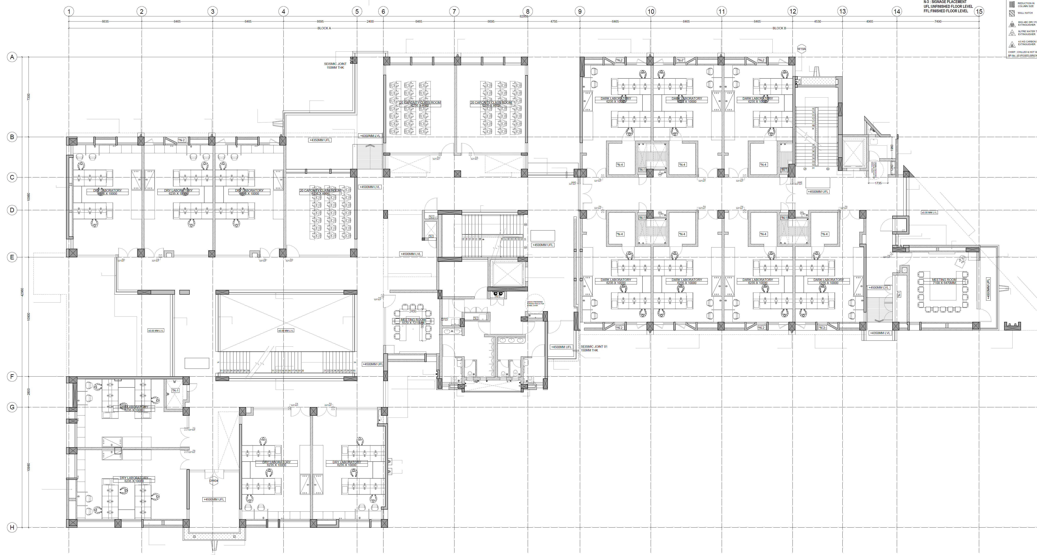
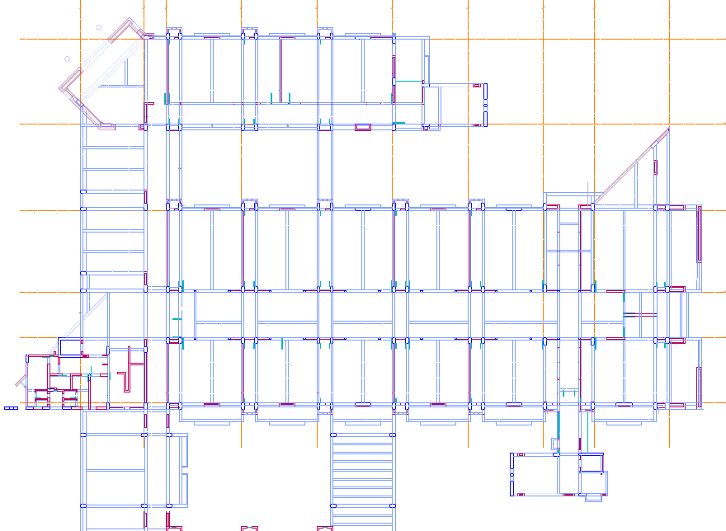
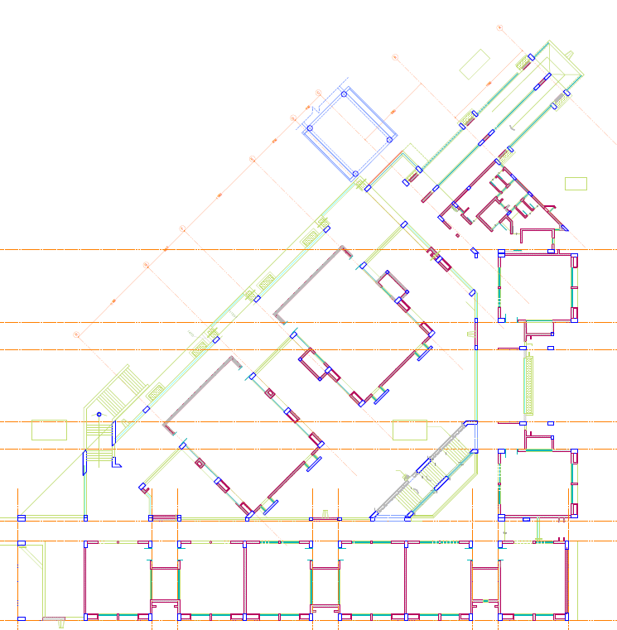
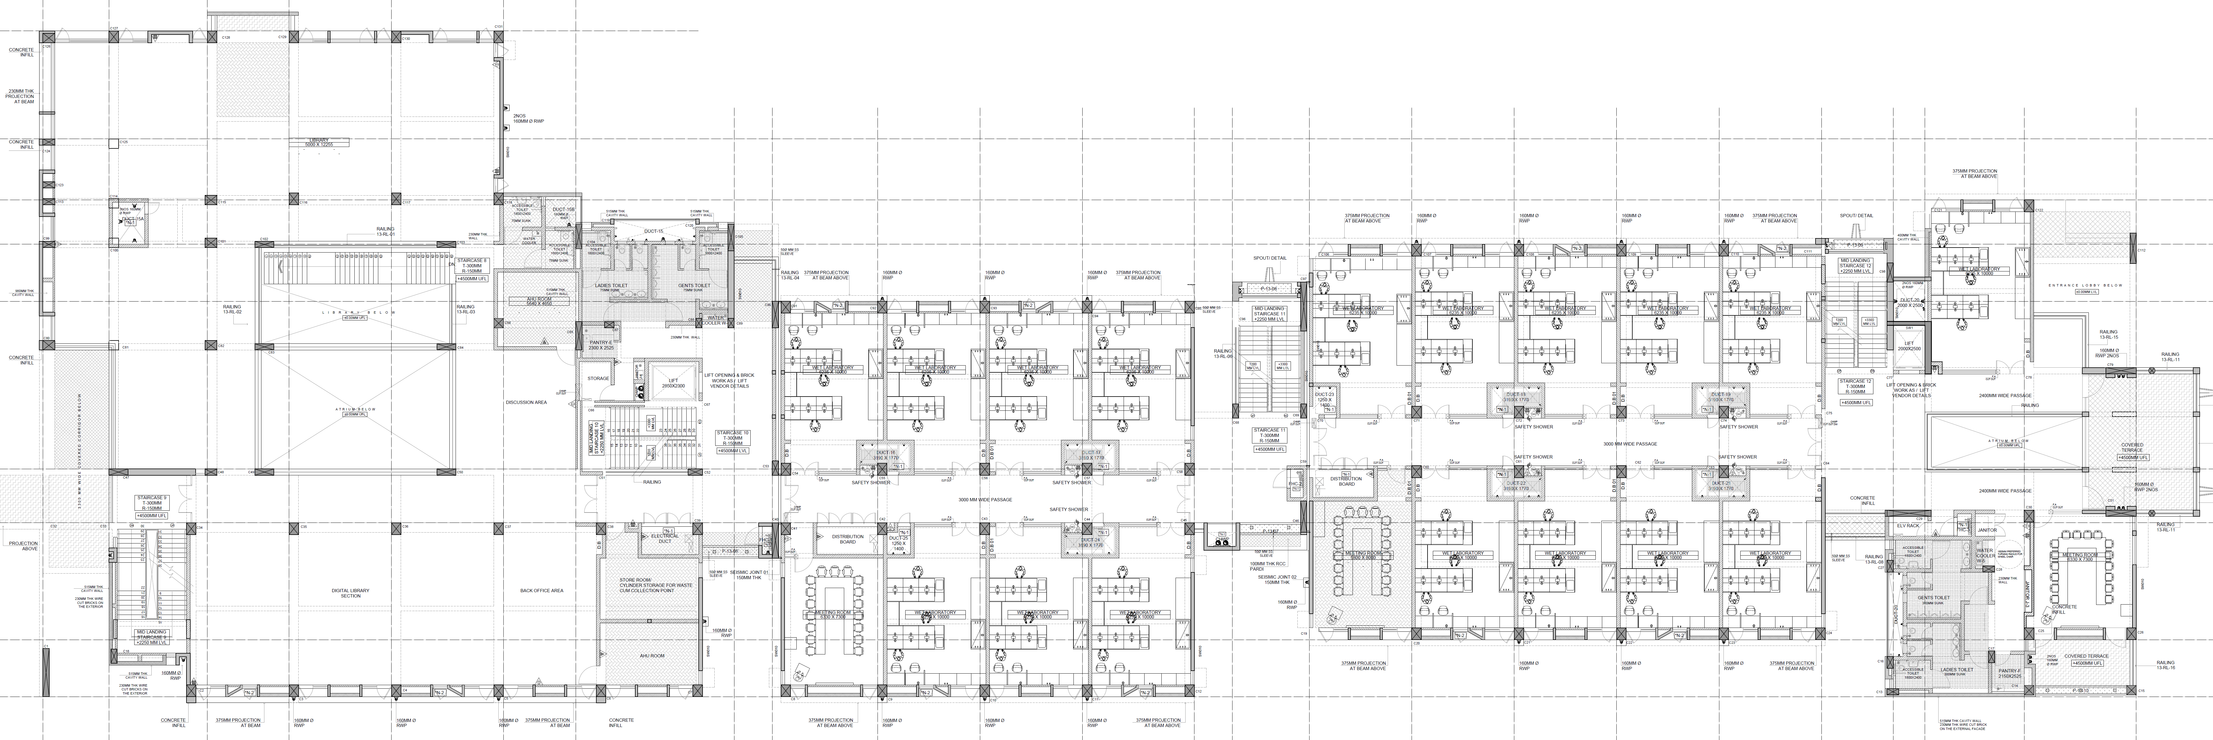
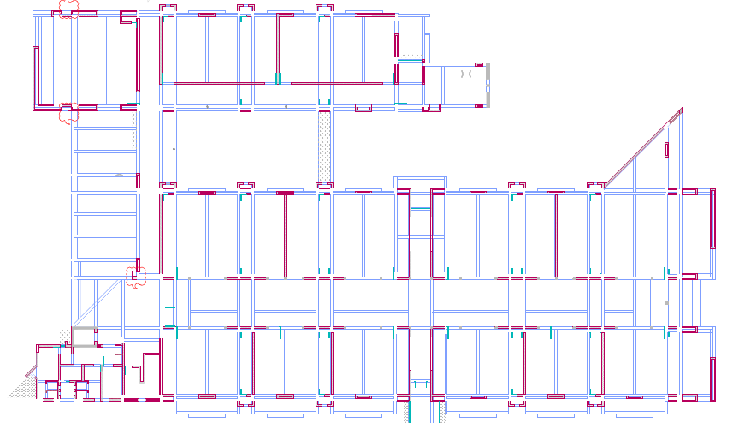
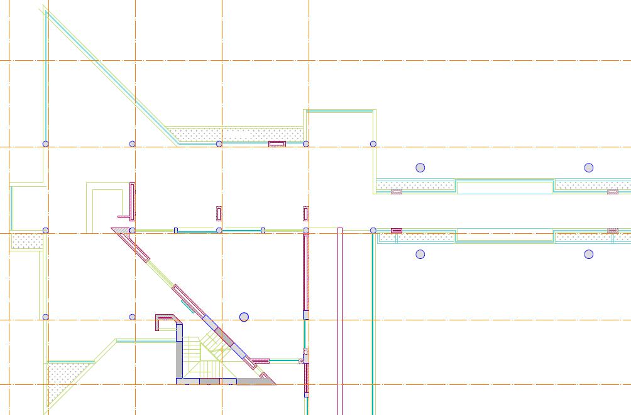
First Floor
AB1
AB2
150 CR
Teaching
150 CR
AB10
Institute Archives
70 CR
150 CR
Admin
Accounts
Comm
AB3
CCL
205
206
207
208
109
Dy. Registrar
211
Registrar
205-206
MM
201-202
MSE
Maker Bhawan
CBS
Teaching
201
202
203
204
202
203
214
213
212
211
210
213
AB11
Chemistry
215
215
214
Phys
Phys
219
CL
217
216
CL
CL
CL
Phys
AB5
218
ESc
211-212
201
202
203
AB4
CE
CL
CL
AB12
Teaching
208
207
206
205
204
209210
206
205
204
203
202
201
201
Lib
Teaching
CIF
201
202
Bio
206
207
208
209
210
211
109
110
Bio
AB13
202
203
204
205
108
CBS
Bio
Phys
(Partial)
221
220
219
218
217
216
215
214
213
212
Stores
101
107
106
105
104
103
102
Bio
Chem
Fire
Bio
AB9
AB8
AB7
AB6

Slide 5
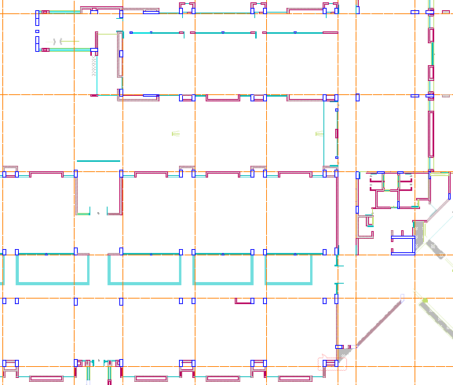
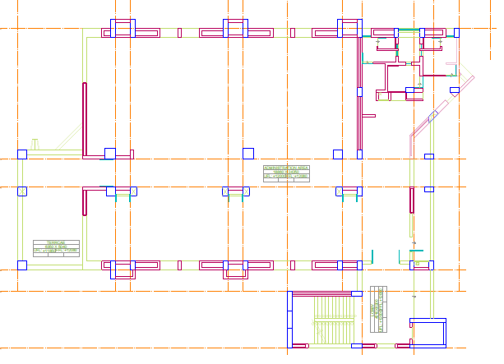
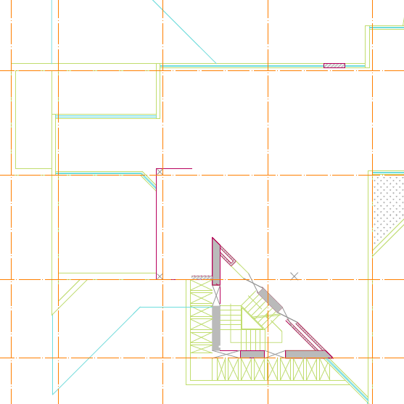
Second Floor
AB3
AB10
Admin
MSE
301
304
305
MSE
Lounge
RP
IIEC
A: IP
D:IA
AR:RnD
PIC:EA
D:RnD
PIC:FA
Adv:FA
AR:FA
302
303
Research Park
Inst. Adv.
RnD, FA, GA
MSE
D:CD
CD
GA
303
304
A B C A B C
Pradipta, Blank, Blank, Emila, Superb, Abhay
D:GA
AR:GA
305
Meeting
Room
Lounge
303
Board
Room
Directorate
A B C D A B C D
305 306
AB11
301 302
308 309
307
HSS/Chem
CL
Cog Sci
(5F, 24S)
311
D C B A D C B A
Abhijit, Blank, Blank, Haritha, Blank, Praful, Amit, Raghavan
A B C
Design
310
CL
(7F, 2WS)
CE
(6F, 35S)
D C B A
ME Chem
AB4
VF
Phys
AB5
AB12
Phys
(8F, 40S)
Math
(6F, 3WS)
ME
HSS
EE
304
305
306
303
CSE
Phys
(6F + 3WS)
AB13
302
313
314
315
316
317
318
319
301
307
309
310
311
312
CL
308
322
321
Phys
AB6
327
326
325
324
323
D
C
B
A
D
C
B
A
320
BSE
(6F, 2WS)
Chem
IWD
Bio
VF
CE
(5F, 2.5WS)
D
C
B
A
D
C
B
A
C
B
A
C
B
A
HSS
e
e
HSS
(5F,2.5WS)
HSS
Math
(8F + 1WS)
VF
Math
HSS
AB9
AB8

Slide 6
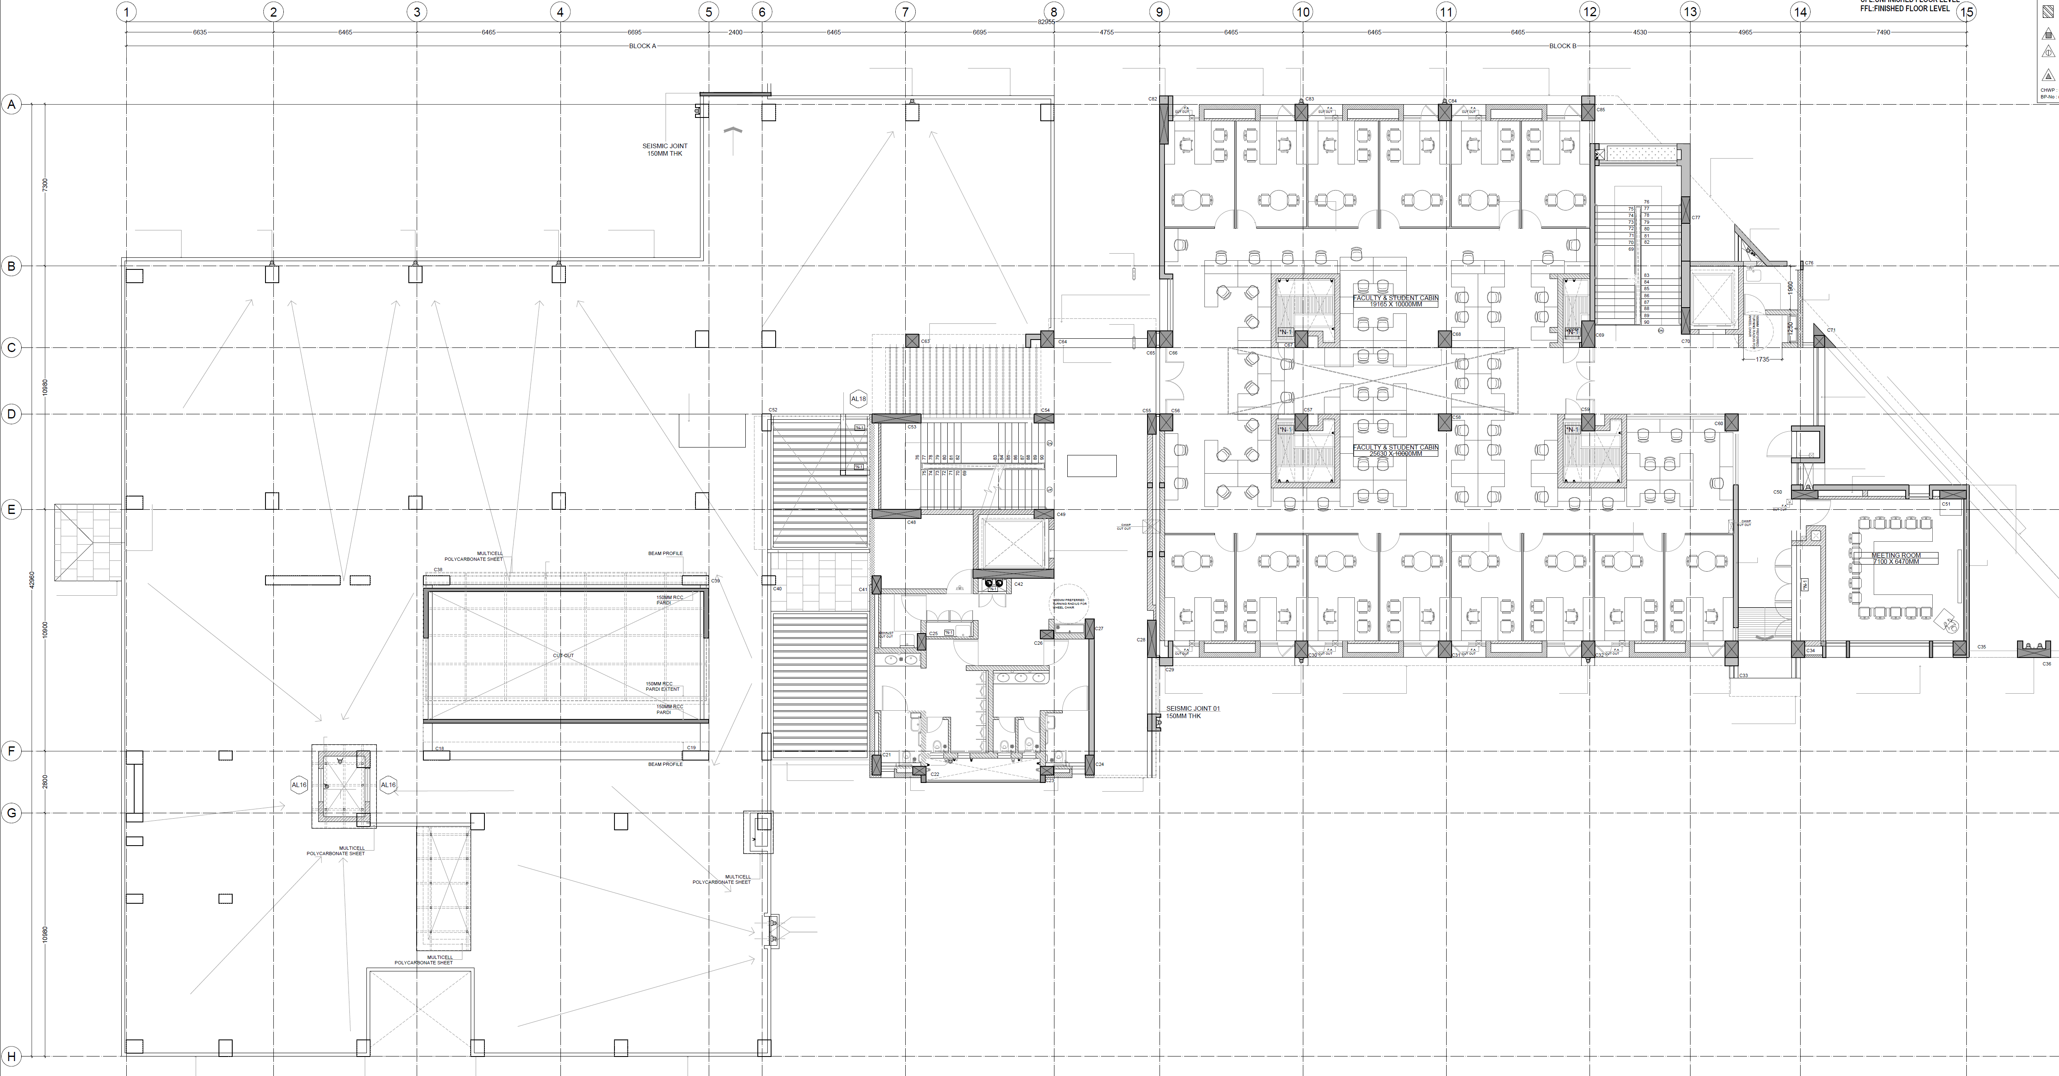
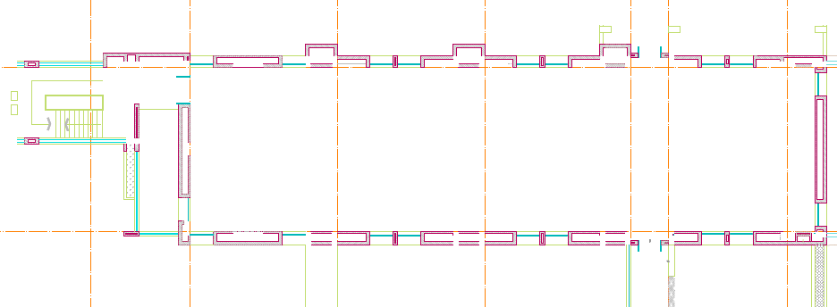
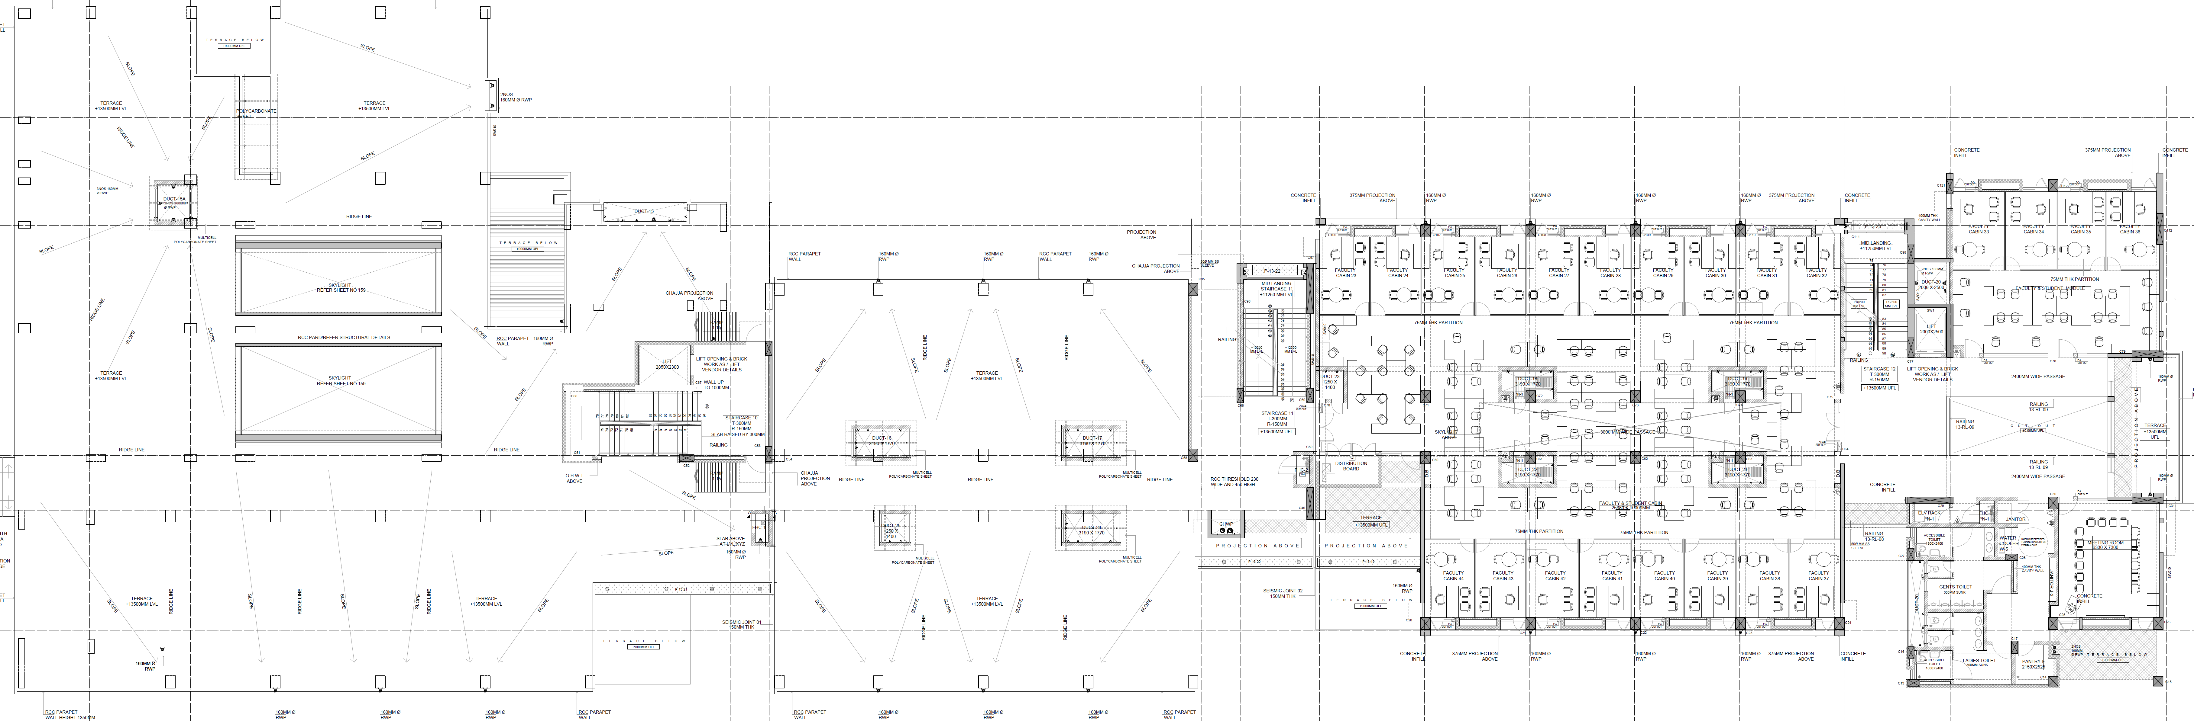
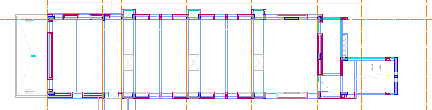
Third Floor
MSE
A
B
C
D
E
F
AB5
AB11
401 (22)
CL (5F+40S)
HSS(2F)
402 (33)
402
Chem (9F, 41S)
AB4
H
G
F
E
D
C
B
A
ESc
A
B
C
D
E
F
AB12
401
A
B
C
D
E
403 (22)
402 (34)
406 (31)
407
405 (34)
F
E
D
C
B
A
H
G
F
E
D
C
B
A
404
CE (5F)
BSE(F5+40S)
AB6
CSE
(22F, 81S)
AB13
A
B
C
D
E
F
G
H
I
J
A
B
A
B
401
405
402-403
H
G
F
E
D
C
B
A
404
AB8

Slide 7
AB3 - GF
KPCSD
Reception Area
Alumni Affairs
CDS

Slide 8
AB3 - FF
Finance, Accounts & Audit Office
3/214
3/215
3/216
3/217
External Relations (Communications)
Unallocated
Unallocated
Admin Store
3/213
3/212
3/210
3/203-204
3/201-202
Unallocated
3/211
3/209
3/205-206
Meeting Room
Establishment & Administration
Registrar Office
Establishment & Administration
Materials Management

Slide 9
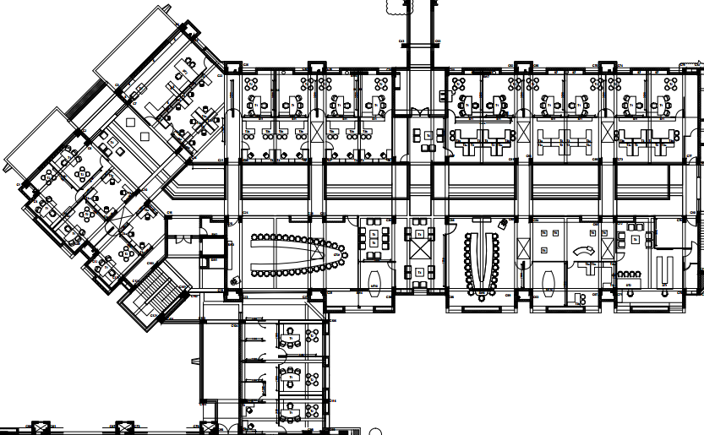
AB3 - SF
3/315
Meeting Room
Unallocated
3/321
Murthy + Anand
Venky
+ Jagadeesh
Nirmal Jha
IA
3/322
3/322
3/327A
R&D
3/328A
3/329A
3/324A
R&D + IA
FA
R&D
FA
3/317
3/326A
3/327B
ER
3/328B
Unallocated
3/316
R&D
IA
IA
R&D
R&D
3/329
3/319
R&D
3/323
3/324
3/326
R&D
FA
3/320
3/327
3/328
3/314
In-Charge ISTF
CD
3/313
3/311-312
CD
GA
GA
3/310
3/308
3/307
3/301
Store Room
Meeting Room
Board Room
3/302
Meeting Room
GA
3/305
3/303
Director Office
3/309
3/304
Meeting Room
3/306B
Pantry
CD
3/306C
3/306J
Chemistry
Dir Office
3/306I
3/306D
Dir Office
Chemistry
3/306H
MM
3/306G
3/306E
ER
Mech Engg
3/306F

Slide 10
AB3 - SF
Meeting Rom
Pantry Rom
CD Office
Chemistry
Dir Office
Chemistry
MM
Ext Relations
ME

Slide 11
AB4 - GF
Conference Facility
ME
4-112
4-111
Fire Lab/Ctr for Safety Engg
4-108 B
ME (985)
4-108
4-109
4-107
4-106
4-102
4-101
4-105

Slide 12
AB4 - FF
Chemistry Labs
(124)
4-213
4-216
4-214
(112)
4-215
4-217
(112)
(296)
4-211
(28)
(6)
(86)
(58)
(86)
4-210
4-209
4-206
4-205
4-204
4-203
4-202
4-201

Slide 13
AB4 - SF
4-335
Chem
Chem
HSS space
HSS
HSS space
4-334
4-333
4-332
4-331
Arnapurna Rath
Angus McBlane
Nishaant Choksi
Arka Chattopadhyay
4-332A
4-330
Cog Sci
4-335A
4-334B
4-334A
4-333B
4-333A
HSS
Ambika Aiyaduri
4-329
4-327
4-328
CE
Climate Lab
ELV room
Madhu
Jayaprakash
Udipta Ghosh
Saumyadip Sett
Chem
4-326
4-316
Chem
4-315A
4-317
4-320
4-321
4-324
4-315
Chem Workspace
Chem Workspace
4-318
4-319
4-322
4-323
Pantry
4-325
ME (12F, 65S)
ME Workspace
MSE space
ME Workspace
ME Worspace
4-314
4-311
4-310
4-307
4-306
4-303
4-302
Harish
Vineet
4-314A
4-313
Dileep
Ravi
Atul
Harini
Vinod Narayan
Harpreet
4-312
4-309
4-308
4-305
4-304
4-301

Slide 14
AB4 - SF
4-335
Chem
Chem
HSS space
HSS
HSS space
4-334
4-333
4-332
4-331
Arnapurna Rath
Angus McBlane
Nishaant Choksi
Arka Chattopadhyay
4-332A
4-330
Cog Sci
4-335A
4-334B
4-334A
4-333B
4-333A
HSS
Ambika Aiyaduri
4-329
4-327
4-328
CE
Climate Lab
ELV room
Madhu
Jayaprakash
Udipta Ghosh
Saumyadip Sett
Chem
4-326
4-316
Chem
4-315A
4-317
4-320
4-321
4-324
4-315
Chem Workspace
Chem Workspace
4-318
4-319
4-322
4-323
Pantry
4-325
ME (12F, 65S)
ME Workspace
MSE space
ME Workspace
ME Worspace
4-314
4-311
4-310
4-307
4-306
4-303
4-302
Harish
Vineet
4-314A
4-313
Dileep
Ravi
Atul
Harini
Vinod Narayan
Harpreet
4-312
4-309
4-308
4-305
4-304
4-301

Slide 15
AB4 - TF
4-406
Chem (9F, 41S)
4-403
4-401C
4-401B
4-401A
4-404
4-405
Sudipta Basu
Iti Gupta
Sivapriya Kirubakaran
Chandrakumar Appaye
Sriram Kanvah (Gundimeda)
4-401
4-407
Chemistry workspace
4-409
4-408
Hub Room
4-402

Slide 16
AB5- GF
Server Room & Student Seating
Common Seating Space
236
Server Room
112
5-101
5-102
Chemical
Colloidal engg lab
164
5-107
CE (1307)
370
Central intstrument Facility
237
Geotech lab
133
ISTF
92
IMS
110
5-103
5-104
5-105
5-106
Super Computing Facility
108
Chemical (1034)
281
Civil
92
5-108
Chemical Engineering lab
147
5-111
Super Computing Facility
109
Chemical Engineering lab
134
CE
5-112
5-110
5-109

Slide 17
AB5- FF
Cog Sci
Seminar Room
Seminar Room
5-201
5-202
5-203
Physics (614)
298
188
Chemical
464
5-207
206
92
5-206
5-204
5-205
92
110
5-208
Chemical
125
5-214
5-212
125
Physics
236
Civil
5-210
Geo Tech lab
73
74
Chandan Mishra
74
5-213
5-211
Rupak Banerjee
74
Gopinadhan Kalon
88
5-209

Slide 18
AB5- SF
Cog Sci (5F, 24S)
Faculty Affairs
Leslee Lazar
Krishna Miyapuram
Pratik Mutha
Meera Mary sunny
Mithun
5-313
5-315A
5-315B
5-316A
5-316B
5-317A
5-312
Mana Shah
5-311
CL
5-310
5-314
5-315
5-316
5-317
5-308
5-309
Cognitive Science
Cognitive Science
Cognitive Science
Cognitive Science
CN Pandey
5-307
5/307
HSS
(CN Pandey)
Mubashshir
5-306
ISO
5-305
5-303
5-304
5-326
5-329
5-330
CE (6F, 35S)
5-336A
5-336B
Faculty Affairs
29
Kaustubh Rane
Prachi Thareja
Kabeer Jasuja
Anand Sengupta
Sudipta Sarkar
Vinod Chandra
Manish Kumar (CE)
Dhiman Basu
Ajanta Sachan
CE?
Vikrant Jain
CL (7F, 26S)
Phys
CL
5-318
5-321
5-322
5-325
5-333
5-334
5-335A
5-302
5-301
CL
CE
5-331
5-332
5-335
5-336
5-337
CL
5-327
CE workspace
CE workspace
5-319
5-320
5-323
5-324
5-328
CE?
Rajkrishna
Phys (8F, 40S)
5-346
5-343
5-342
Math (6F, 35S)
Senior Research Staff Seating
Phys workspace
Phys workspace
Mathematics
Mathematics
5-339
Deepak Singhania
HSS
5-359
5-358
5-355
5-354
5-351
5-350
5-347
5-338
Jagmohan Tyagi
Tanya Srivastava
Chetan Pahlajani
Atul Dixit
Sudhir Arora
5-360
5-357
5-356
5-353
5-352
5-349
5-348
5-345
5-344
5-341
5-340
5-339A

Slide 19
AB5- TF
5-404A
5-404B
5-404C
5-406
CL (5F+40S)
5-403
Ashish XaXa
5-404D
5-402
Sameer V Dalvi
Nitin U Padhiyar
Pratyush Dayal
Sharmita Lahiri
Chinmay
HSS
5-401
5-404
5-405
ELV Room
PhD Seating (40)
Vacat

Slide 20
AB6- GF
Faculty Lounge
CE
386
6-101
Structures & Hydrology lab
Structures & Hydrology lab
6-102
6-103
Bio Waste
6-103A
Electric Engg Lab 1
6-104
6-107
Fuel cell &Gas Research lab
(ME/Che)
Electric Engg Lab 2
Chem
ME
6-106
6-105
Maritime Engg
MSE
Physics lab
Chemistry lab
6-111
6-110
6-109
6-108

Slide 21
AB6- FF
Classroom
Classroom
BSE
6-201
6-202
6-203
BSE
BSE
Cognitive Sciences
BSE
6-206
Physics
6-207
6-204
6-205
BSE
Chemistry
Fire Lab
BSE
BSE
BSE
6-213
6-212
6-211
6-210
6-209
6-208

Slide 22
AB6- SF
Interview Room
Gopi
Nadhan Kalon
Baradhwaj Coleppa
B Prasanna Venkatesh
Krishna Kanti Dey
6-311
Phys (7F + 24S)
Arpan Bhattacharya
6-315B
6-312
6-314A
6-314B
6-315A
6-316A
Interview Room
6-310
Physics
Physics
6-314
Physics
Physics
6-313
6-315
6-316
SR Gandhi
Math
CL
6-309
6-308
R.R.Puri
Phys
6-307
6-306
BV Puvar
N.Ramakrishanan
6-305
6-303
Soumya Harish
6-304
Udit Bhatia
Saumyakanti Khatua
Gadadhar Mishra
Susobhan
Vimal Mishra
Pranab Mohapatra
Chem
FA
29
BSE (F5, 26S)
CE (4F, 26S)
RN Singh/ V D Sharma
6-317
6-320
6-321
6-324
6-325
6-327A
6-329A
6-330
6-331
6-334
6-335
6-336A
Bio
6-302
6-301
6-318
6-319
6-322
6-323
6-326
6-328
6-336
6-337
BSE Workspace
BSE Workspace
CE
6-327
CE
6-332
Alok
(HSS)
UPS
6-329
6-333
HSS
BSE
Cog Sci
6-349
Math (8F + 13S)
HSS
HSS
6-350
HSS
CLI
HSS
HSS
6-358
6-357
6-354
6-353
6-346
6-343
6-342
6-339
6-338
6-352
6-351
6-348
6-347
6-345
6-344
6-339a
Kim Jooyoung
MA
Math
Cog Sci
6-340
6-359
6-356
6-355
Math
Madhumita Sengupta
Rohit Mishra
Indranath Sengupta
Sanjay Amrutiya
6-341
Aksha Vatwani
Jaison Manjaly
(HSS)

Slide 23
AB6- TF
CE (5F)
6-403
6-405
6-406
6-407B
Sameer Patel
19
6-404
12
Gaurav S
20.4
Amit Prashant
23.4
23.4
23.4
23.4
23.4
BSE(F5+40S)
6-407A
6-407C
6-407D
6-409
6-408
25.6
PHD Seating
6.6
6-402
6-407
6-401
UPS

Slide 24
GROUND FLOOR PLAN – BLOCK 10
Computer Lab
(70)
10-104
Computer Lab
(70)
10-105
10-103
Class Room
(250)
Class Room
(70)
SWAYAM PRABHA
10-101
Class Room
(70)
10-102

Slide 25
1ST FLOOR PLAN – BLOCK 10
CLASSROOM
(150)
10-201
10-202
CLASSROOM
(150)
Computer Lab
(70)
10-203
205
Computer Lab
(70)
10-204

Slide 26
2ND FLOOR PLAN – BLOCK 10
10-304
MSE
10-305
MSE
10-301
Char. Lab
10-302
Char. Lab
10-303

Slide 27
GROUND FLOOR PLAN – BLOCK 11
MSE
102
(70)
103
104
105
101
(70)
109
108
107
106
Makers Bhavan
110
Design
(Official allocation to Design is pending approval)

Slide 28
1ST FLOOR PLAN – BLOCK 11
DARK LAB - LIGHT
20 CAPACITY
CLASSROOM
DRY LAB - LIGHT
MEETING ROOM - 15 SEATER
MEETING ROOM - 10 SEATER
MSE
205
20 CR
206
20 CR
207
208
209
201
202
203
Design
204
(20 CR)
214
213
212
211
210
(15)
215
(11)
219
ME
217
216
Design
218
Design
(Official allocation to Design is pending approval)

Slide 29
2ND FLOOR PLAN – BLOCK 11
MEETING ROOM - 15 SEATER
MEETING ROOM - 18 SEATER
FACULTY
CABINS
STUDENTS
SEATING
MSE
(14F, 48S)
303
(18)
304
(18)
11-305A 11-305B 11-305C 11-306A 11-306B 11-306C
Design
(21)
305 306
301 302
A B C D A B C D
(34)
301 302
309 308
(27)
307
(15)
D C B A D C B A
11
29
312 - 313
MSE
312 A-C
ME
311 and 310
18
311 A-B and 310 A-B
(Official allocation to Design and ME is pending approval)

Slide 30
3RD FLOOR PLAN – BLOCK 11
11-401A 11-401B 11-401C 11-401D 11-401E 11-401F
Ctr for Res Comm
401
(22)
403
(33)
402
(15)
Faculty Affairs
11-401H 11-403G 11-403F 11-403E 11-403D 11-403C 11-403B 11-403A

Slide 31
GROUND FLOOR PLAN – BLOCK 12
DARK LAB - HEAVY
12-102
12-103
12-104
12-101
CE
12-108
12-107
12-106
12-105
12-109

Slide 32
1ST FLOOR PLAN – BLOCK 12
DARK LAB - LIGHT
MEETING ROOM –
12 SEATER
12-202
12-203
Earth Sc
12-201
12-208
12-207
12-206
12-205
12-204
(12)

Slide 33
2ND FLOOR PLAN – BLOCK 12
12-302A 12-302B 12-302C 12-303A 12-303B 12-303C
Cog Sci
CL
22
12-301
(15)
Elect
31
12-308
(11)
12-304
(12)
12-306D 12-306C 12-306B 12-306A 12-305D 12-305C 12-305B 12-305A
12-307
(11)

Slide 34
3RD FLOOR PLAN – BLOCK 12
MEETING ROOM –
12 SEATER
FACULTY
CABINS
STUDENTS
SEATING
MEETING ROOM –
15 SEATER
Civil
Earth Sci
403A-C and D-F
402(A-E)
Earth Sci (11F, 65S)
406(A-F)
401
10 seats
Earth Sci (12 seats)
34S
31S
34
Future CSE (50%) + Maritime Engg (50%)
407
12-404
405
Future CSE
Maritime Engg
405 A-D
(Official allocation to Maritime Engg for student seating space is pending approval)

Slide 35
GROUND FLOOR PLAN – BLOCK 13
DRY LAB - HEAVY
20 CAPACITY
CLASSROOM
WET LABS –
HEAVY
CONFERENCE ROOM –
23 SEATER
MEETING ROOM –
15 SEATER
LIBRARY
Library
101
CIF
112
106
XRD
107
XRD
108
109
NMR
110
PPMS
102
103
104
TEM
105
TEM Sample Prep
Elect
117
116
115
114
UTM
126
125
124
123
122
Elect
120
119
SEM
118
Micro CT
113
Classrooms
Meeting Rooms

Slide 36
1ST FLOOR PLAN – BLOCK 13
LIBRARY
WET LABS –
LIGHT
MEETING ROOM –
15 SEATER
MEETING ROOM –
17 SEATER
Library
201
CIF
211
CSE
206
207
208
209
210
202
203
204
205
217
216
215
214
213
221
220
219
218
212
CSE

Slide 37
2ND FLOOR PLAN – BLOCK 13
DRY LAB - LIGHT
WET LABS – LIGHT
EE
304
305
306
303
319
CSE
318
302
EE
314
317
315
CSE
313
316
310
EE (22F, 90S)
309
311
312
301
307
(8)
308
(8)
29
322 A-D
←
321 A-D
←
327 A-D
←
Nihar Joycee Tarun Jhuma
38 326 A-D
←
Pallavi Raghavan Rajendran Naran
325
(17)
23
324 A-C
←
323 A-C
←
320
(15)

Slide 38
3RD FLOOR PLAN – BLOCK 13
FACULTY
CABINS
STUDENTS
SEATING
MEETING ROOM –
15 SEATER
CSE (22F, 81S)
402A,B 403A,B
401A-J
20
31
30
404
405 A-H

